Slide 1
Early Stopping & Regularization
Instructor: Dr. Yan Yan

Slide 2

Recipe of Deep Learning
YES
Early Stopping
Good Results on Testing Data?
Regularization
Dropout
YES
New Activation Function
Good Results on Training Data?
Adaptive
Learning Rate

Slide 3
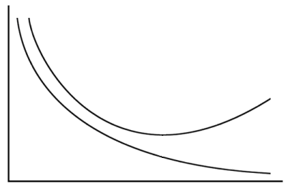
Early Stopping
Total
Loss
Stop at here
Validation set
Testing set
Training set
Epochs
Keras:
http://keras.io/getting-started/faq/#how-can-i-interrupt-training-when-the-validation-loss-isnt-decreasing-anymore

Slide 4
Recipe of Deep Learning
YES
Early Stopping
Good Results on Testing Data?
Regularization
Dropout
YES
New Activation Function
Good Results on Training Data?
Adaptive
Learning Rate

Slide 5
Regularization
New loss function to be minimized
Find a set of weight not only minimizing original cost but also close to zero
Regularization term
Original loss
(e.g. minimize square error, cross entropy …)
L2 regularization:
(usually not consider biases)

Slide 6
Regularization
L2 regularization:
New loss function to be minimized
Gradient:
Update:
Weight Decay
Closer to zero

Slide 7
Regularization
L1 regularization:
New loss function to be minimized
Update:
Always delete
…… L2

Slide 8
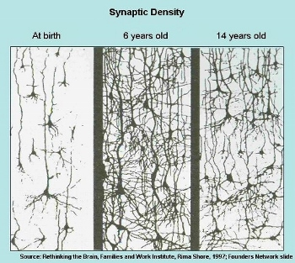
Regularization - Weight Decay
Our brain prunes out the useless link between neurons.
Doing the same thing to machine’s brain improves the performance.

